Slide 1
Appdynamics Engineer Training: Chapter 4 Concepts
Notes:
Hello, this Sandro Guglielmin, I am responsible for the technical enablement of Sales Engineers and Consultants of both AppDynamics as well as our Partners and in this chapters we will talk about the fundamental Concepts that are behind AppDynamics.
As with the previous chapter and the ones following, Please take your time to complete and understand each chapter thoroughly. Feel free to submit questions by email should you have any problems with attending the course or any part of it’s content.

Slide 2
What’s this about?
We will take a look at how AppDynamics works, it’s essential functional building blocks from a conceptual perspective. We will understand why AppDynamics works the way it works
Notes:
We will look at the main functional areas and understand how and also why we built Appdynamics the way it is built and why it works the way it works.
At the end of this chapter you should feel comfortable with explaining in broad strokes the conceptual foundations that characterize AppDynamics. You should internalize how this foundation is the basis for the Value Proposition it brings to a customer and how this value is realized.

Slide 3
Overview
The Dev vs. Ops Situation
Why Transactions
Transactions
Discovery
Metric Collection
Performance Classification
Diagnostics
Snapshots
Diagnostic Sessions
Notes:
Here is an overview of the topics in this chapter
First we want to set the context and analyze what creates the need for APM solutions in the first place, where the problem actually lies that we address.
With that background We will then focus on understanding why Appdynamics focuses it’s Management capabilities on Transactions, Business Transactions as we call them. You have heard this term before and will hear it again many more times. Suffice to say for the Moment that a Business Transaction really is the main building Block for AppDynamics to realize it’s vision of APM.
We also want to understand how Appdynamics determines Performance and applies it in real time in it’s Decision Making Process. This is actually one of core functionalities upon which our solution and ultimately our value proposition rests.
We then will take a look at how Diagnostics is performed, what we mean by it, what triggers it and what data elements are collected. We’ll introduce the concepts of snapshots and Diagnostic sessions.
Let’s start with setting context.

Slide 4

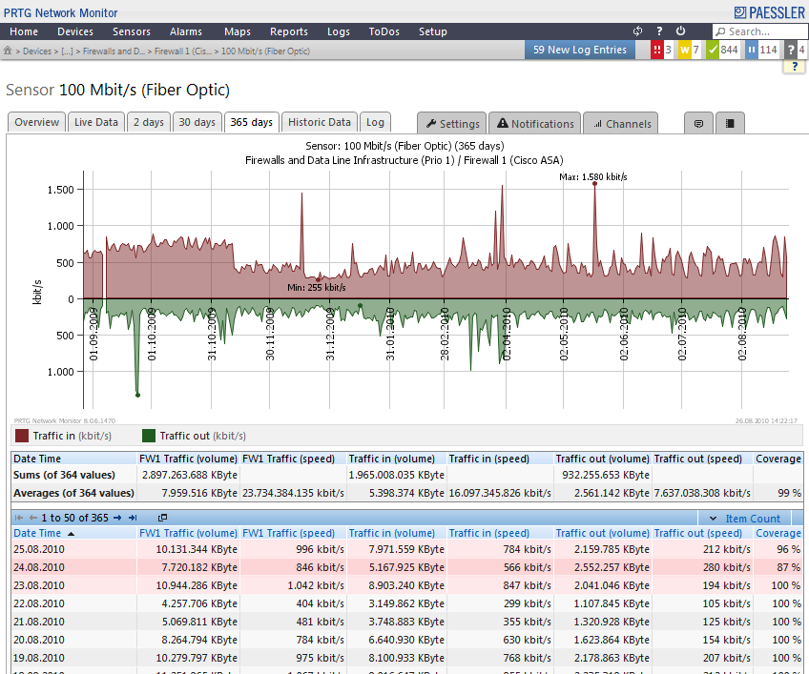
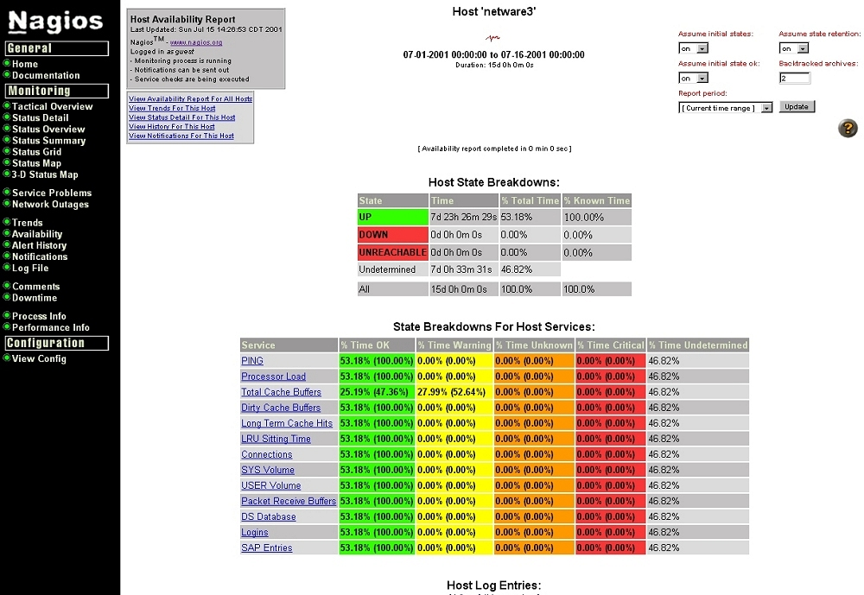
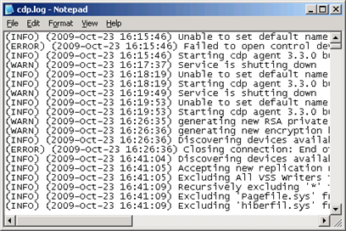
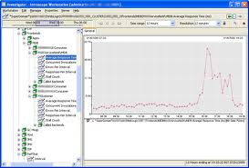
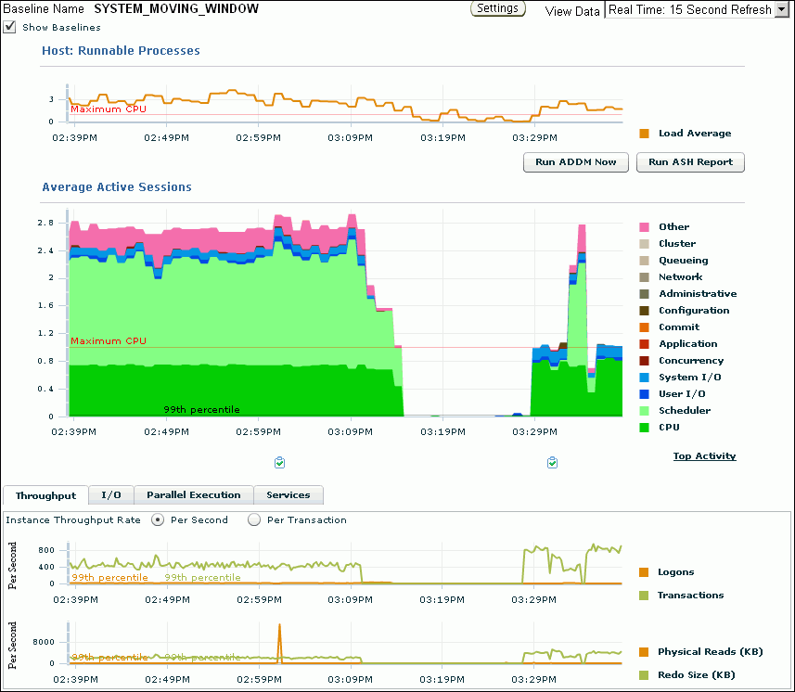
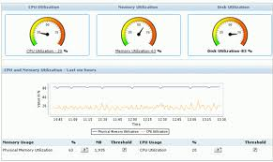
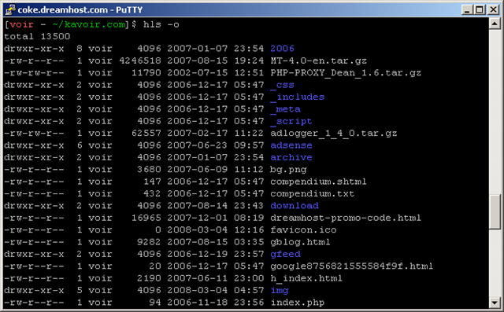
The Dev vs. Ops Situation
I told you. It’s NOT the network!!
On it now…
need Emily’s help though.
In a Perfect World
In the Real World
Problems in production
Dev troubleshooting
‘War Room’ involving multiple teams
Steve, did you check the logs?
It’s been unstable since last week’s release!!
Marcus, did you test this in QA?
Call Dev ASAP!
Can’t tell from the logs. Sorry.
I don’t know either. I can’t reproduce it.
ds
Not my code…
The guy who wrote it
isn’t here anymore.
The QA build isn’t exactly like Production.
Notes:
(Click (image rotates in)
In a perfect world the dev teams would simply write new code, add new functionalities, satisfy enhacmeent requests. Ops on the other hand woud simply run and scale applications on their production system and the two Teams would happily ride into the sunset together, metaphorically speaking.
Click (overlay image)
In the Real World however things are not as smooth, problems do happen in production impacting end uses, customers, directly affecting revenue. Resolution of these problems is often difficult. Teams from across the Dev / Ops divide need to collaborate to isolate the issue, often under time pressure while leaving their actual work waiting.
This scenario is not unusual at all and it is the very reason why there is a Market for APM. AppDynamics is the first APM solution to address this problem from the Production Point of View, enabling the reduction of MTTR, the mean time to repair a problem. And, now with the latest release also addresses the End User Visibility as well as the Database Monitoring Requirements that often are often inherently connected with the main concern of APM.

Slide 5


Taking the Transaction Centric View …
From Systems to Business Transactions
99.9% Availability
$
Business Transactions
Business Transactions
Application
Application
JVM
OS
Network
Servers
Database
Browser
JVM
OS
Network
Servers
Database
Browser
Common Approach was
Monitoring Infrastructure
End-Users Experience
Business Transactions
Notes:
So how can this problem be tackled. The past monitoring approaches focused on the infrastructure, servers, networks, Disk Storage devices were monitored and still are being monitored for that matter.
But the utilization metrics provided with System monitoring tools were essentially used as proxies for application health and with the change in how compute infrastructure is being used this is no longer a viable option.
With the advent of compute clouds Servers no longer need to be purchased and installed and deployed. They are rather provisioned on demand, dynamically depending on load. Causing system monitoring metrics to loose their relevance with regards to be able to give any indication of the applications performance.
(click, fly in image)
A much better approach is to get to ‘higher ground’, to monitor the end user activity in a transactional context. It does not matter whether an application is currently running on 1 or a 100 or a 1000 servers, the response time to the user needs to be consistent. That’s why monitoring by transaction’ is much better than any proxy metric. But do not confuse this approach with End User Monitoring in the traditional Sense. EUM does not give nay details about application execution, what we are talking about here is application performance in context with a End Users Business activity. That is what Business Transactions represent.

Slide 6


… across distributed, complex Systems
Distributed
Monolithic
Release 1.1
Release 1.2
Release 1.23
Release 1.5
.NET
Amazon EC2
Windows Azure
Tomcat
CLOUD
Release 2.4
Release 2.5
Release 2.6
Release 3.0
Tomcat
Mule, Tibco, AG
ESB
Tomcat
VMWare
Login
Search Flight
View Flight Status
Make Reservation
WEB 2.0
Weblogic
Memcached
Oracle
Release 4.4
Release 4.5
Release 4.6
Release 5.0
Browser Logic
AJAX
Web Frameworks
Release 1.4
Release 1.5
Release 1.6
Release 2.0
Coherence
SOA
Hadoop
Cassandra
MongoDB
.NET
MQ
JBoss
AGILE
Release 3.4
Release 3.5
Release 3.6
Release 4.0
Release 1.4
Release 1.5
Release 1.6
Release 2.0
BIG DATA
SQL Server
ATG, Vignette,
Sharepoint
Notes:
Another trend makes System Monitoring irrelevant for Application Monitoring. Modern Service Oriented Architectures move applications away from monolithic deployments
(Click)
towards systems distributed over a number of Servers, with distinct services running on separate machines. From a System monitoring point of view this would require the manual correlation of metrics across multiple to monitor the application as a whole. A tedious challenge at best, an impossible one in many cases.
It is for these reasons that AppDynamics has been architected with one objective in mind: To be able to provide a transaction centric view in a distributed environment.
Let’s take a look how this is accomplished.

Slide 7
… to identify Business Transactions …
The Agent, the Transaction Identification Engine
Requests
Agent
Transaction Identification Engine
Checkout.
Auto Discovery
AddToCart.
Custom Rules.
ViewCart.
Notes:
AppDynamics deploys agents, we know as as much. One of the main tasks the agent performs is to identify and classify requests as they are being received by the Application. It does so by using a pre defined set of rules to ‘auto discover’ transactions. These rules cover the most common technology stacks and frameworks used to build Web based applications in Java, .NET and in PHP today.
Given that these rules are applied to the container of the application and not to the application code itself Appdynamics can discover applications without needing prior custom configuration, tailored ot the application to be monitored.
But here is always the possibility that an application is not written with one of the supported frameworks. In such cases custom rules can be added to provide discovery capabilities and give business transaction. If you find yourself in such a ‘custom configuration’ situation, check the online community and resources first, it si likely someone has already seen the particular framework or open source component you are delaing with. We share such configurations so you don’t have to re-invent them.
With this discovery process we now obtain a classification of requests, but that is only half of the story, requests also need to be correlated in a distributed environment. Again the transaction identification engine takes on the job.

Slide 8

… and follow their execution anywhere
The Agent, the Transaction Correlation Engine
First significant entry point on tier
JMS/Messaging Bus
Tier4
Tier1
Tier2
Tier3
Requests are discovered where they first appear
Servlet – URI
Struts Action – Action Name
Web Service
EJB
Spring
Subsequent remote calls are ‘tagged’ with a unique ID added to the payload
HTTP header
JMS property
Agent on target System checks for ID, treats request as continuation of ongoing business transaction.
Notes:
Let’s take another look at this process
(click, animation starts)
A request is as we know discovered as a business transaction. Since we do not know where in a distributed system a request could be first identified, all agents of that system can potentially discover new transactions.
However remote calls made by a already discovered request, are carrying a unique ID, added by the agent on the calling, the ‘upstream,’ service to the remote cals payload. With this ID an agent on the ‘downstream’ system can tell that the request does not need to be discovered as a new transaction but that it is the continuation of an already discovered transaction.
With this ‘tagging’, a business transaction can now be followed across a distributed system with any number of distinct services, provided that they are all instrumented with an AppDynamics Agent. This mechanism is also known as ‘tag and follow’.

Slide 9
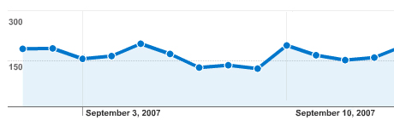
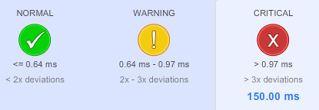
… to enable Performance Awareness …
The Agent, the Metric Collection Engine
{
Response Time
Business
Transaction
Performance
Profile
CPU Time
Load
Errors
WEB 2.0
ESB
Login
Search Flight
View Flight Status
Make Reservation
Weblogic
Oracle
Browser Logic
AJAX
Web Frameworks
Release 1.4
Release 1.5
Release 1.6
Release 2.0
Notes:
Since now we have requests identified and discovered as business transactions and correlated by tagging and following across a distributed system, we can now also measure their performance in this transactional, distributed context.
(click, start animation)
Performance has many aspects and as such not one but a whole series of metrics are computed on a per business transaction basis, Response Time being one of the most important of course, but also throughput and cpu consumption are calculated and persisted over time. Thus Metrics become time series, trends if you will that keep track of all business transactions and by consequence of the entire application. From these trends we can now calculate baselines, thresholds if you will that allow us to decide in real time whether a request of a given particular business transaction performs within the boundaries set by its baseline or has broken those thresholds..
(click, play animation)
And since all agents on a business’ transaction’s distributed path collects metrics, a problem can be spotted exactly where it occurs.
(Click, play animation)
And just like that, any performance problem will flag the entire business transaction as problematic. This Real Time decision making process is crucial to AppDynamics ability to be used in production monitoring systems as it allows us to automatically find and react differently depending on a requests performance.

Slide 10

… and Real-Time Decision making
The Agent, the Performance Management Engine
Checkout.
Agent
Performance Management
Normal
Baselines Thresholds
Slow
Error Custom Configuration
Error
Notes:
(Click, play animation)
It should be clear now that the AppDynamics agent acts intelligently to distinct normal from non-normal performance
(Click, play animation)
With that distinction we can now focus on the non-normal performing requests and record all information that is relevant to allow for an effective root cause analysis, a trace of the method execution sequence,
(Click, play animation)
the payload of data sent by the end user request, data elements as they have been processed in various phases of by the execution, entries written to log files, the SQL statements used to query databases, stack traces in case of exceptions. All this information is captured by the agent in what we call a snapshot, but again, only if the transaction is slow! AppDynamics finds slow transactions automatically, and it captures all relevant information needed to do root cause analysis with a snapshot. By being able to do this selectively we keep the overhead, the additional cpu used just for the purpose of monitoring to a very minimum! Other APM tools can only either trace everything or nothing, causing either too much overhead or not capturing enough information. This ability is a major key technical differentiation. Be sure to well internalize these ‘mechanics’.

Slide 11
Yet, Danger lurks …
Response Time
CPU Time
Load
All is well …
Application is monitored
Outlier requests are snapshot’ed
… until a ‘Systemic Issue’
i.e. a database crash
need for lots of snapshots
potentially Increase overhead to application already in trouble!!
The Solution? A Diagnostic Session!
Contract to limit amount of snapshots (n snapshots/min for n minutes)
Kicks in if threshold of n% slow requests/min is breached
Errors
WEB 2.0
ESB
Login
Search Flight
View Flight Status
Make Reservation
Weblogic
Oracle
Browser Logic
AJAX
Web Frameworks
Release 1.4
Release 1.5
Release 1.6
Release 2.0
Login
Search Flight
View Flight Status
Weblogic
Oracle
Release 1.4
Release 1.5
Release 1.6
Release 2.0
Notes:
(click, play animation)
And now we do have the ideal prerequisites. Both Dev and Ops team can focus on their respective tasks as AppDynamics will constantly monitor for performance problems and provide snapshots when needed for the dev team to quickly analyze and implement corrections if necessary.
Yet there is one scenario that is not covered yet. A systemic issue can wreak havoc and even cause carefully balanced baselines and thresholds to not accurately reflect the current situation. If for example a database crashes, all of a sudden all requests making calls to that database would, according to their baselines become slow, causing AppDynamics to record a large number of snapshots which in turn would negatively affect overhead, using up more cpu right in a moment when the application is already in a precarious state!
In order to prevent this scenario fro happening AppDynamics knows the concept od a Diagnostic session. A diagnostic session is a contract, a stipulation that under extreme circumstances expressed in a threshold of slow and/or erro’ed requests per minutes, instead of indiscriminately recording snapshots for all slow requests only a preset number of snapshots for a preset amount of time will be recorded. This stipulation will avoid escalating overhead impact on an application afflicted by a systemic issue. The reason why this approach is viable is simple. All requests are slow for the same reason (in our example all requests are slow because they time out because of a missing database connection)! We do not need a snapshot for every request, a few snapshots all confirming the same root cause are sufficient!
Let’s walk thru an example

Slide 12

Diagnostic Session Example
Let’s assume
100 req/min
> 20% slow req/min to start Diag. Session
5 snapshots/min
for 3 min
10:00 AM
10 slow
10 Request Snapshots
10:01 AM
22 slow
22 Request Snapshots
10:02 AM
Start Session
25 slow
10:03 AM
5 Request Snapshots
43 slow
5 Request Snapshots
10:04 AM
16 slow
5 Request Snapshots
10:05 AM
Stop Session
Notes:
Lets assume we have an application in production with a constant load of 100 requests per minute. Let’s also assume that the diagnostic session settings, are set to 20% of slow requests per minute, meaning if I have more than 20% slow requests compared to the total requests per minute then a diagnostic sesison dhould take control over how it is decided when to take a snapshot. Let’s also assume that the dianostic session is to last for 3 minutes and should take 5 snapshots per minute. All these settings are of course configurable.
Click
With a constant load of 100 requests per minute, if we have 10 slow requests from minute 10:00 to 10:01 we’ll get 10 snapshots, one for each slow request as it is the default behavior.
Click
During minute 10:01 to 10:02 we have 22 slow requests and we will take 22 snapshots. We also have crossed the threshold, so now form the next minute on, a diagnostic session will take over.
Click
Now for the next three minutes we will get 5 snapshots independently of how many slow snapshots there really are. The likelihood that all these requests are slow for the same reason is very high, thus even the few sanpshots taken will point to the common root cause.
Click
After the stipulated period, the diagnostic session ends and the default behavior of determining snapshots will again be in effect. One can also configure the wait time between diagnostic sessions.

Slide 13
Summary
In this lesson we learned
why we implemented a transaction centric monitoring Approach in AppDynamics.
how the agent discovers business transactions and how they are followed in a distributed system
that metrics are collected and are being used to determine baselines from which the performance for each request is determined
That for each non normally performing request a snapshot is taken that contains all necessary data to perform an efficient root cause analysis
And that in case of a systemic issue a diagnostic session will manage and control how many snapshots are taken in order not to adversely affect the application with potential additional overhead.
Notes:
Read from slide
Feel free to repeat this chapter should there be any aspect that is no clear to you. Do so befre you start the next chapter. Thank You for your time and attention

